Slide 1
Housekeeping
Please mute your microphones.
Post any questions in the chat – will be answered at the end.
This webinar will be recorded.
All recordings and presentations will be on the website shortly after the webinar here: www.crowcon.com/webinars

Slide 2
Gas Detection Requirement in Water/ Wastewater Industry
May 2020

Slide 3
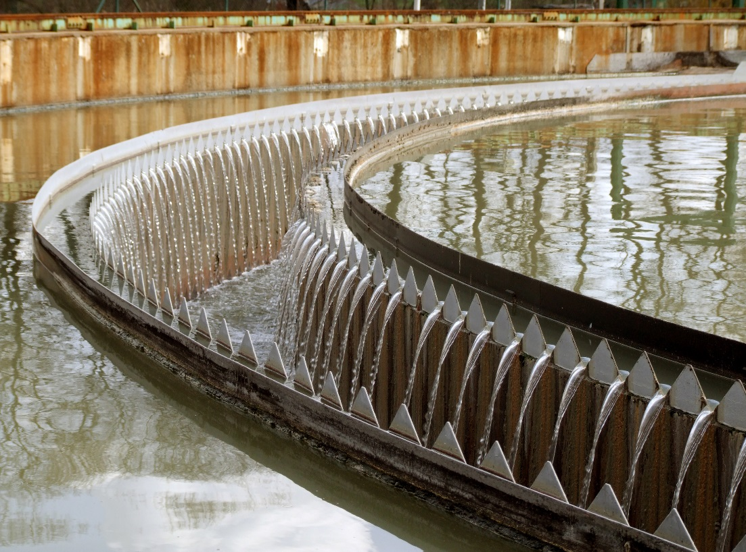
Outline
Process overview
Where are the gas risks
Why do we measure
How/ what detectors are used
Sampling solutions case study

Slide 4
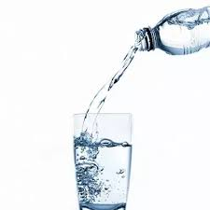
Introduction
Frequently regarded as a simple commodity, water is a vital element of day-to-day life, both for personal health and to industrial and commercial users.
Aim of water treatment is to produce water that is clear, odourless, colourless and safe for consumption.
With the 24/7 nature of water treatment plant, equipment must be maintained year- round.
The water industry is a wet and dirty environment with multiple toxic and flammable gas hazards as well as risk of oxygen depletion.
Crowcon is proud to have provided a wide variety of water industry users with gas detection equipment; keeping workers safe around the world.

Slide 5
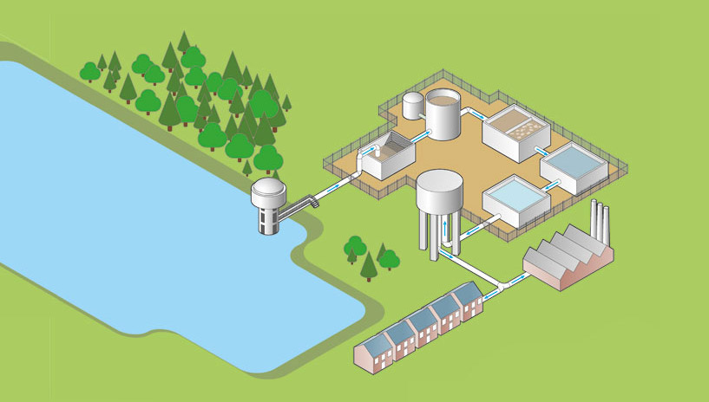
Water Treatment Flow Diagram
Collection and Storage
Screening
Coagulation/ flocculation
Sedimentation
Filtration
Final treatment
3
4
2
5
1
6

Slide 6
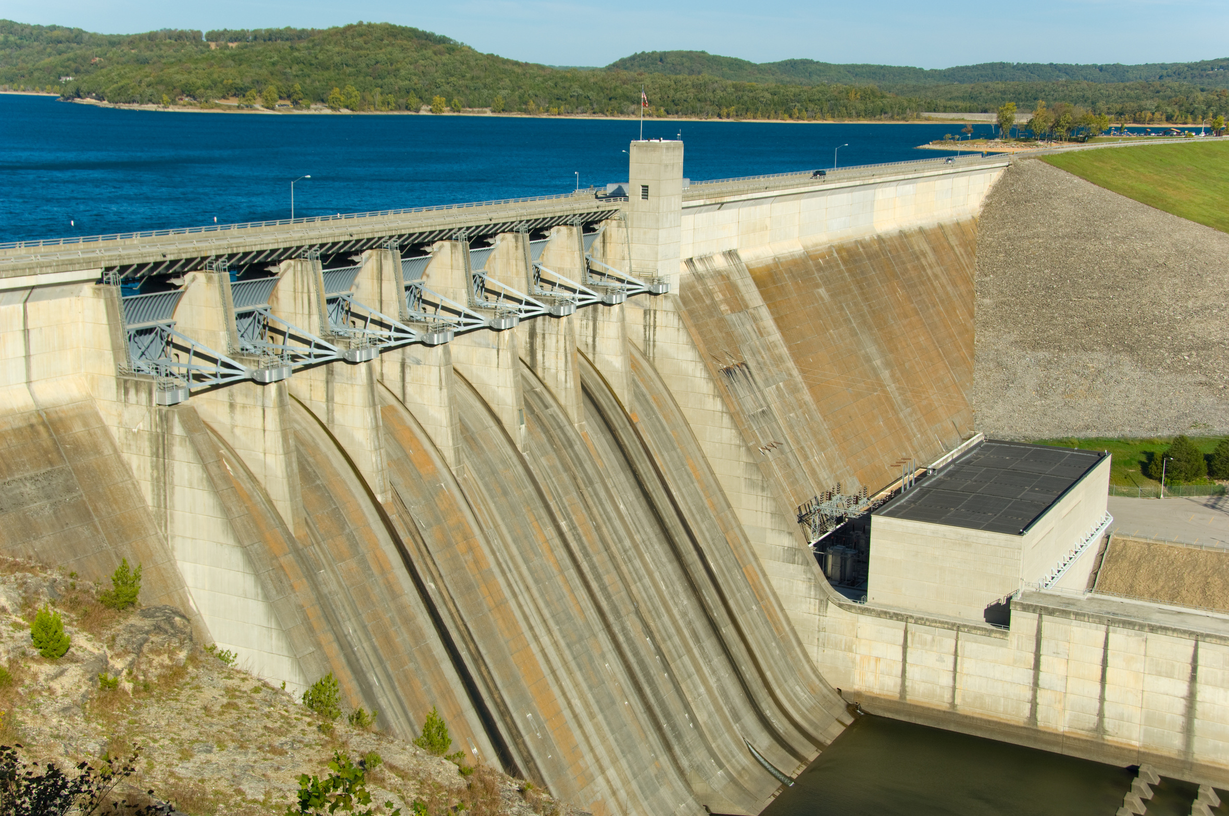
Water Treatment
Collection and storage
Water is gathered from surface sources and stored in open reservoirs, or below-ground basins.
The water is then pumped to treatment facilities.
Screening
Screening removes floating objects that may be in the incoming water.
Screening prevents these objects from causing problems further down the line.

Slide 7
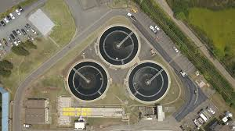
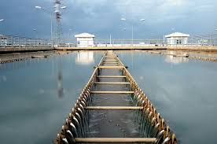
Water Treatment
Coagulation & Flocculation
A chemical coagulant is often added to bind together suspended material, called flocculation.
This causes the suspended matter (floc) to settle more readily and then be removed in the sedimentation tank.
Sedimentation
The water then passes through several sedimentation vessels, in each stage, heavy sediment settles to the bottom whilst clear water moves on.
Suspended particles are also removed by membrane filtration in some treatment facilities

Slide 8
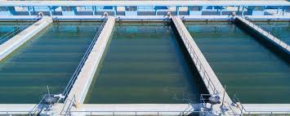
Water Treatment
Filtration
Rapid gravity filtering passes the water through a tank of course sand, this traps unwanted particles
Slow sand filters passes the water slowly through finer sand, removing smaller particles
Granular activated carbon is used to remove pesticides, organic compounds, unpleasant tastes and odours

Slide 9
Water Treatment
Final treatment
Finally, the water flows into a chemical contact tank, where disinfectant chemicals are added to kill bacteria.
Chlorine (Cl2) gas remains the most common form of disinfectant.
Sodium hypochlorite is also commonly used as it is effective and reduces storage and handling risks.
Ozone is used to supplement chlorine dosing
Finally, the water goes through a series of water quality tests before it is piped to the customers.
The water is then pumped close to where it is needed and stored ready for use (e.g. in water towers).

Slide 10
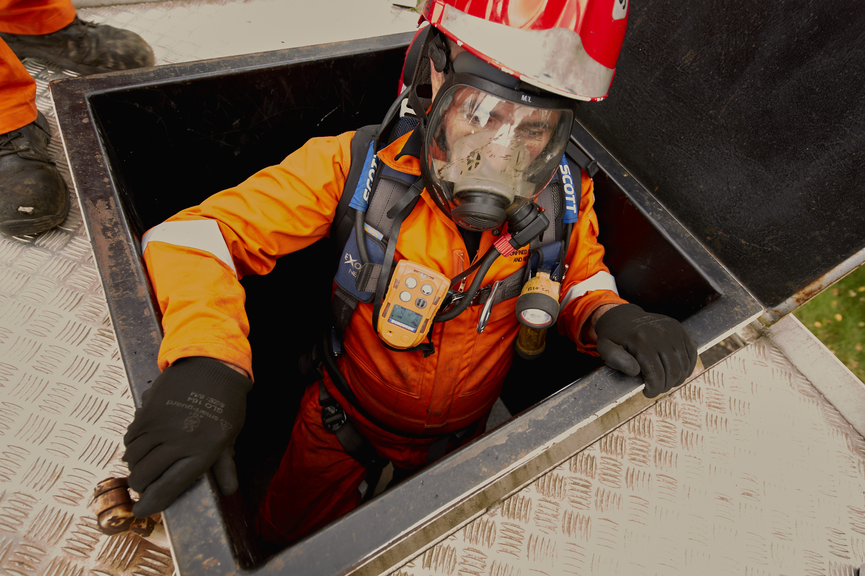
Gas Hazards – Water Treatment
Process Area | Hazards | Measurement type
Collection | LEL, H2S, O2 | Personal detector for confined space
Screening | LEL, H2S, O2 | Personal detector for confined space
Coagulation/ Flocculation | LEL, H2S, O2 | Personal detector for confined space
Sedimentation | LEL, H2S, O2 | Personal detector for confined space
Filtration | LEL, H2S, O2 | Ambient monitoring, personal detector
Final Treatment - Testing laboratories | CL2, O3, NH3, HF | Ambient monitoring, personal detector

Slide 11
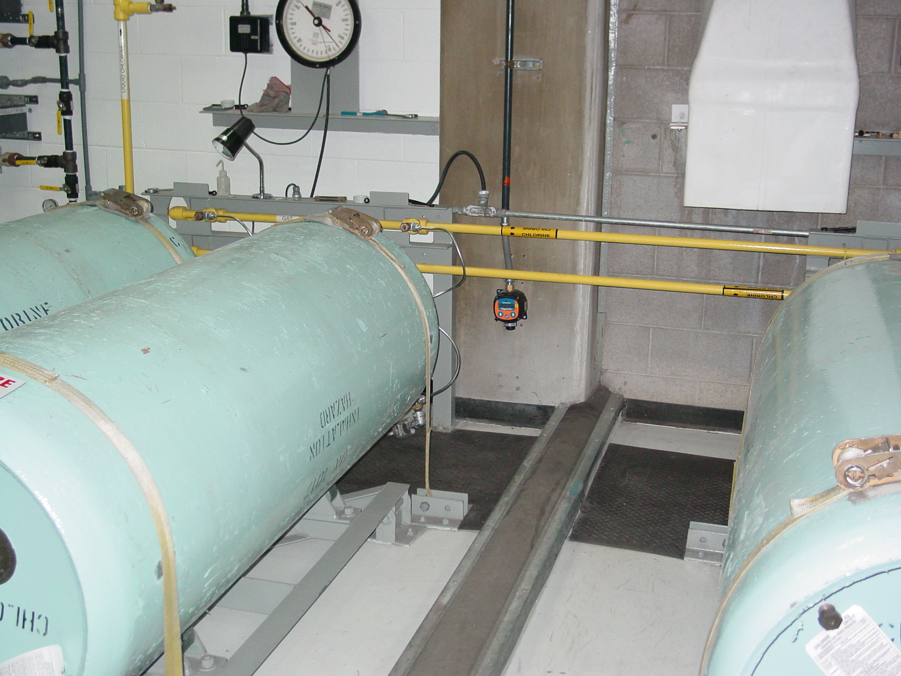
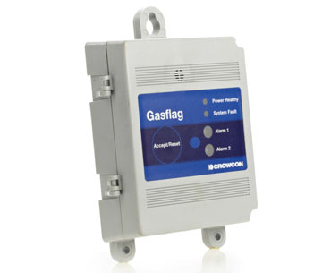
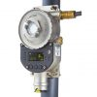
Water Treatment – Chemical Dosing
Storage areas of the chemicals used within the final treatment stage should have robust gas detection systems installed.
Small escapes of CL2, NH3, SO2 or O3 can be extremely harmful.
Fixed gas detection will be needed to ensure storage areas are monitored, commonly linked to external alerts (sounders & beacons) to ensure workers are notified of any increases in gas level as well as having the capability to drive executive action such as activating ventilation fans.
XgardIQ with remote sensor is also well suited where transmitter can be mounted up to 15m away.

Slide 12
Wastewater Process
Wastewater typically consists of:
Domestic wastewater
Processed Industry wastewater
Drainage and rainwater run off
Treatment allows final discharge into natural water sources or reclaimed for used as potable water.

Slide 13
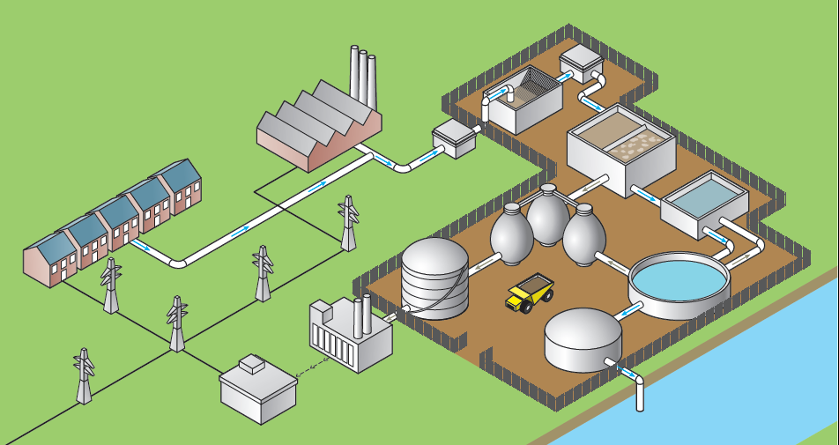
Wastewater Treatment Flow Diagram
Waste generation
Pumping stations
Screening
Primary treatment
Secondary treatment
Final treatment
Sludge treatment
Power generation
3
2
4
1
7
5
6
8

Slide 14
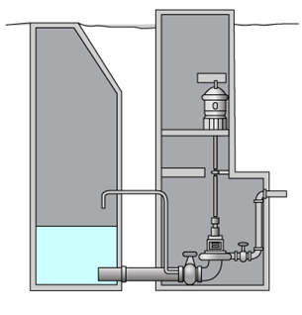
Primary Treatment
Pumping stations
Pump or lift stations, are usually unmanned; designed to handle raw sewage fed from underground gravity pipelines
Traditional sewage pumping stations incorporate both a wet and dry well, separated by an internal divide. Pumps are installed below ground level on the base of the dry well with inlets below water level
Sewerage will have CH4 & H2S due to decomposition of organic matter
Dry wells are underground, confined spaces and require appropriate precautions for entry
Recent technologies incorporating deep tunnel sewers to convey used water by gravity to centralised wastewater treatment plant saves cost and reduce maintenance required in pumping station.

Slide 15
Primary Treatment
Screening
Wastewater enters the treatment plant through pumping stations
With the help of gravity, the used water flows through the various treatment tanks and automated mechanical screens to remove the debris.
This is followed by grit settling tanks or vortex grit chambers to settle and remove the heavier sandy materials present in the used water.
Settling Tanks/ Primary Clarifiers
Water flows through very slowly across large tanks called primary clarifiers.
Solid pollutants in suspension in wastewater will settle to the bottom of the tanks.
light materials like scum, greasy materials float up to the surface of the tank and is collected and combined with the sludge for further treatment.

Slide 16
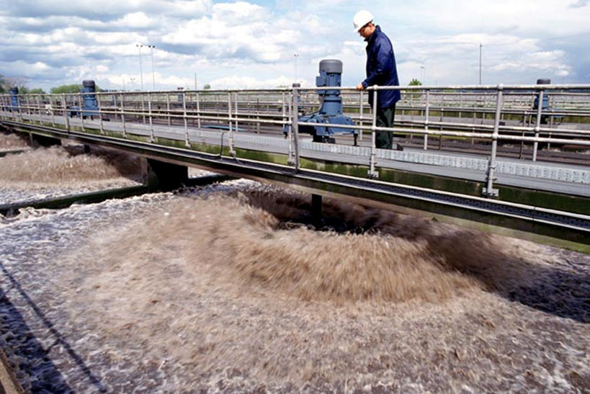
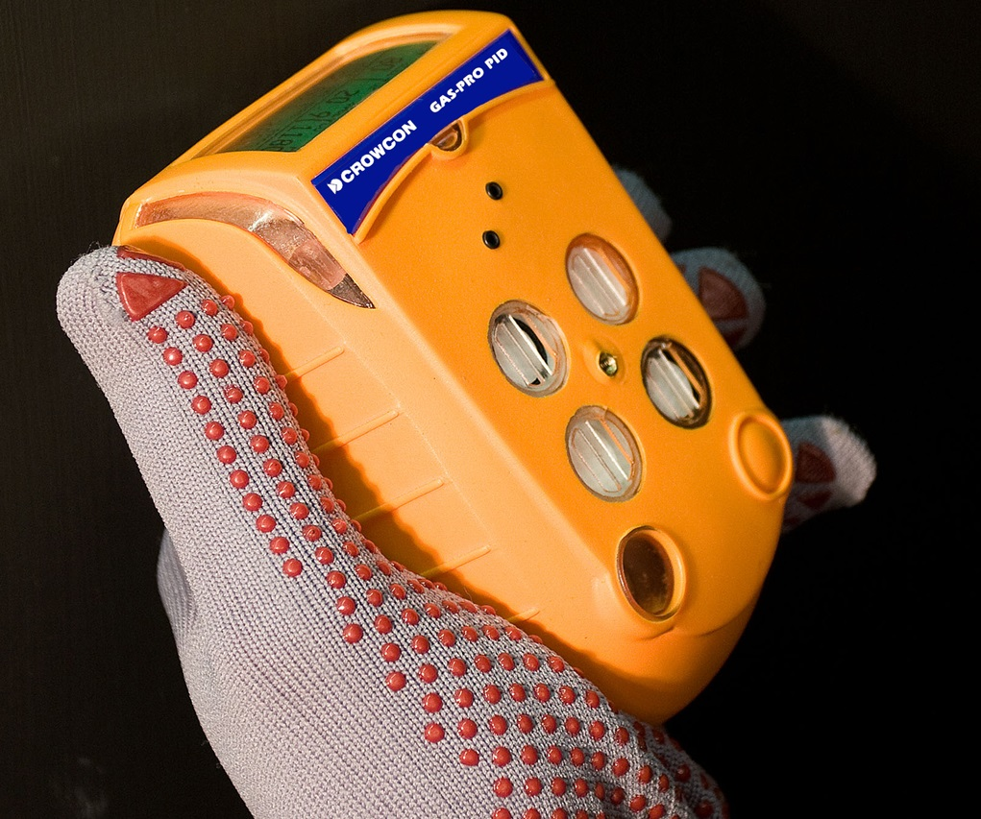
Primary Treatment
Aerobic Digestor or Surface Aerator
The wastewater is mixed with a culture of micro-organism known as activated sludge in an aerated tank
Air is pumped through the water. As organic matter decays, it uses oxygen, aeration replenishes the oxygen and keep the activated sludge in good working condition
By the time the used water reaches the end of the aeration tanks, most of the pollutants would have been absorbed by the micro-organism.
The mixture of sludge and the treated water is then channeled into the final clarifiers.

Slide 17
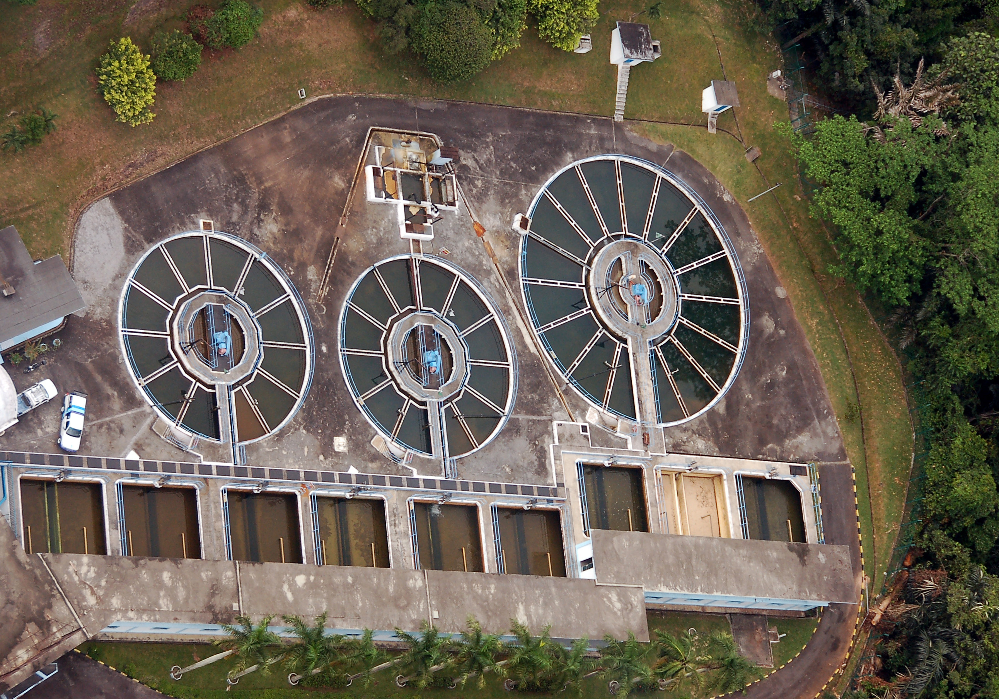
Secondary Treatment
Secondary Clarifiers
Here, the sludge settles out of the wastewater and is pumped out of the tanks
The clear supernatant water at the top of the tank is collected and discharged from the tanks as final effluent.
A portion of the sludge is constantly returned back into the aeration tanks to sustain the optimal bio-reaction process.

Slide 18
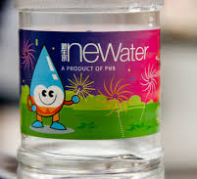
Secondary Treatment
Final treatment
Wastewater flows into a chemical contact tank, where chemicals (e.g. chlorine) are added to kill bacteria
Chlorine is mostly eliminated as the bacteria are destroyed, but sometimes it must be neutralized by adding other chemicals. This protects fish and other marine organisms
Treated water (called effluent) meeting the discharge standards of 20 mg/l biochemical oxygen demand (BOD) and 30 mg/l total suspended solids (TSS) is either discharged to river/ sea or sent for further treatment.
In Singapore the final effluent is further treated using UF membrane and reverse osmosis technologies to high grade water called NEWater.

Slide 19
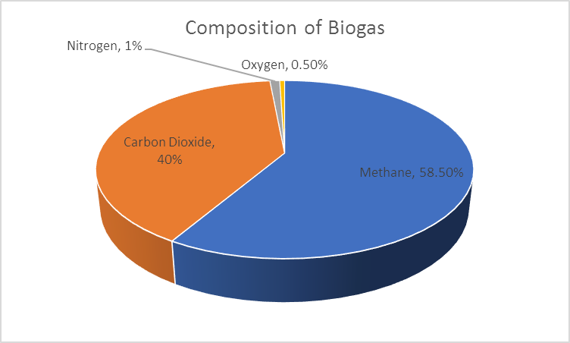
Secondary Treatment
Sludge Digester (Anaerobic)
Activated sludge is transferred to anaerobic digesters, where it is mixed with a different culture of micro-organism thriving in an oxygen-deficient environment further breaks down the sludge into biogas – a process that takes 20-30 days.
Biogas is high in CH4 (54%) & CO2 (40%), but it also has over 3000ppm of H2S
High levels of H2S can cause corrosion and mechanical failure in generators so it must be treated before biogas can be used as a source of energy.
Sludge Dewatering
The digested sludge is dried via dewatering centrifuges
The sludge is then incinerated and ashes used as landfill.

Slide 20
Secondary Treatment
Power generation – from Waste to Energy
Water companies have become increasingly involved in generating electricity from sewage sludge as the high level of methane represents a rich source of energy
Some facilities have an on-site power station (combustion engines) used to convert the biogas into electricity
Alternatively, the biogas is used directly to provide fuel to heat the digesters and other processes

Slide 21
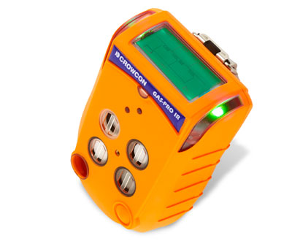
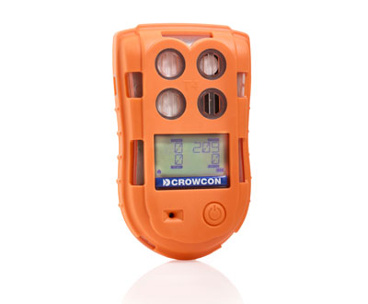
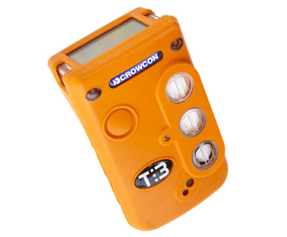
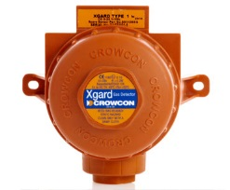
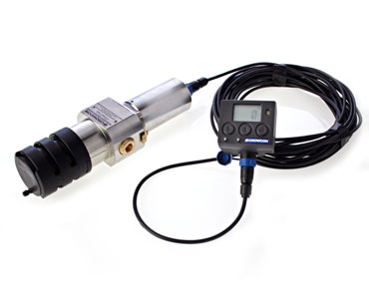
Gas Detection Solution
 |  |  | Crowcon Products
 |  |  | Clip SGD | Gasman | T3 | Gas-Pro | T4 | Xgard | Xgard IR | Xgard Bright | IRmax | ESU
Gas | Overview | Areas
Hydrogen sulphide | Caused by the breakdown of organic matter | All | ✓ | ✓ | ✓ | ✓ | ✓ | ✓ |  | ✓ |  | ✓
 | Intensified during sludge digestion | Digester
Methane | Result of anaerobic decay of organic matter | All |  | ✓ | ✓ | ✓ | ✓ | ✓ | ✓ | ✓ | ✓ | ✓
 | Intensified during sludge digestion | Digester
 | Used to heat the digesters and stored for use | Storage and pipework
Oxygen | Used during the aeration cycle | Storage and pipework | ✓ | ✓ | ✓ | ✓ | ✓ | ✓ |  | ✓ |  | ✓
 | Displacement by carbon dioxide &/or methane | Confined spaces
Chlorine | Used during water disinfecting | Storage and dosing |  | ✓ |  | ✓ |  | ✓ |  | ✓ |  | ✓
Sulphur dioxide | Used to treat chlorinated water prior to release | Storage and dosing |  | ✓ | ✓ | ✓ |  | ✓ |  | ✓ |  | ✓
Flammable vapours | Flammable liquids washed in with rain/ wastewater | Inlet, wet wells & screening |  | ✓ | ✓ | ✓ | ✓ | ✓ | ✓ | ✓ | ✓ | ✓
Carbon monoxide | Engine and heater by-product | Wet & dry wells, confined spaces | ✓ | ✓ | ✓ | ✓ | ✓ | ✓ |  | ✓ |  | ✓
Carbon dioxide | Oxygen displacement | Confined spaces, digester |  | s | s | ✓ |  | ✓ | ✓ | ✓ |  | ✓
Ozone | Used during filtration & disinfection | Storage, filtering and dosing |  | ✓ | ✓ | ✓ |  | ✓ |  | ✓ |  | ✓
Ammonia | Used during water disinfecting | Storage and dosing |  | ✓ | ✓ | ✓ |  | ✓ |  | ✓ |  | ✓
Chlorine dioxide | Used during water disinfecting | Storage and dosing |  | ✓ |  | ✓ |  | ✓ |  | ✓ |  | ✓

Slide 22
Gas Hazards – Primary & Secondary Treatment
Process Area | Hazards | Measurement type
Pumping station wet well | LEL, H2S, O2 | Sample draw using ASU
Screening | LEL, H2S, O2 | Ambient monitoring
Grit Removal | LEL, H2S, O2 | Ambient monitoring
Aeration sediment | LEL, H2S, O2 | Ambient monitoring
Oxygen Aeration | LEL | Ambient monitoring
Disinfection | CL2, O3, NH3 | Ambient monitoring
Process Area | Hazards | Measurement type
Clarifier | LEL, O2 | Sample draw using ASU
Sludge pumping dry well | LEL, O2 | Ambient monitoring
Anaerobic Digester | LEL, O2 | Ambient monitoring
Sludge dryer | LEL, O2 | Ambient monitoring
Digester Gas processing | LEL | Ambient monitoring

Slide 23
EU Directive 2017/164 IOELV (Indicative Occupational Exposure Limit Values)
OELV (Occupational Exposure Limit Values)
Substance | Chemical Formula | LTEL (8hr TWA) ppm | STEL (15 min TWA) ppm
Ammonia | NH₃ | 25 | 35
Carbon dioxide | CO₂ | 5000 (0.5% by vol) | 15000 (1.5% by vol)
Carbon monoxide | CO | 20 (30) | 100 (200)
Chlorine | CL₂ | 0.3 | 0.5
Chlorine dioxide | CLO₂ | 0.1 | 0.3
Hydrogen sulphide | H₂S | 5 | 10
Ozone | O₃ | 0.1 | 0.2
Sulphur dioxide | SO₂ | 0.5 (2) | 1 (5)
TWA resume function is unique to T4 as it ensures TWA is calculated accurately even when switched off and on again.
Effective 21 August 2018, values in red indicate changes from previous revision

Slide 24
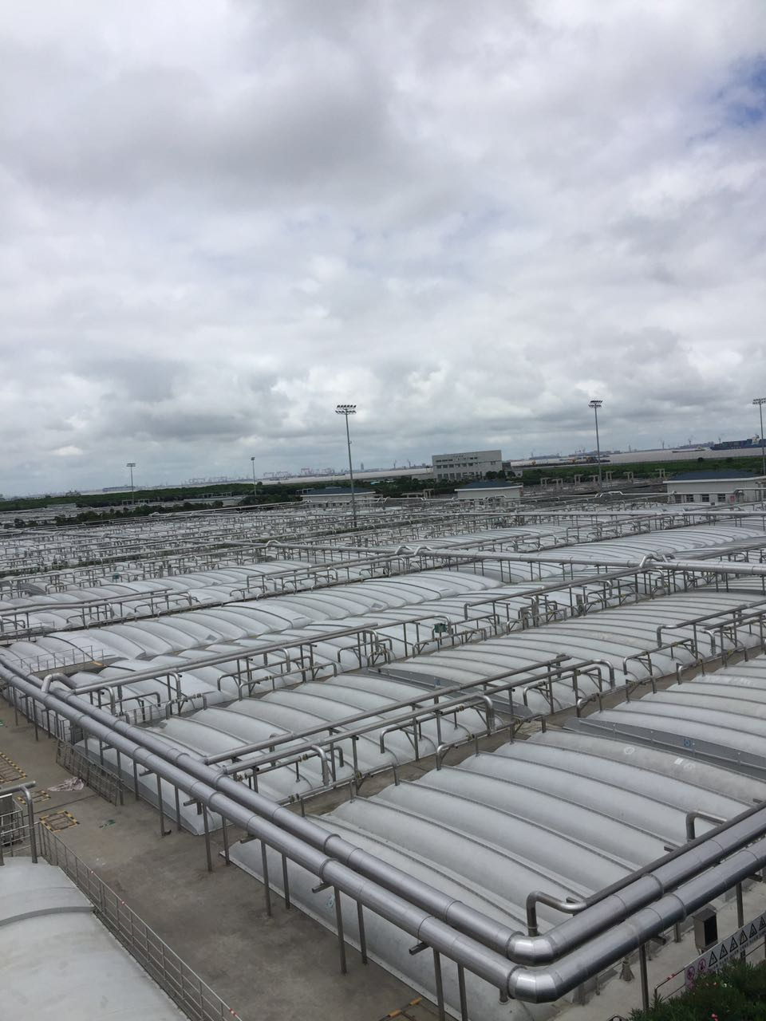
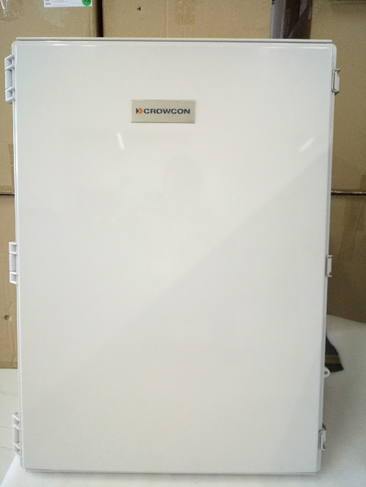
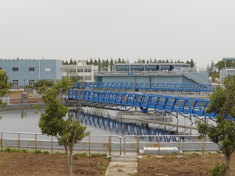
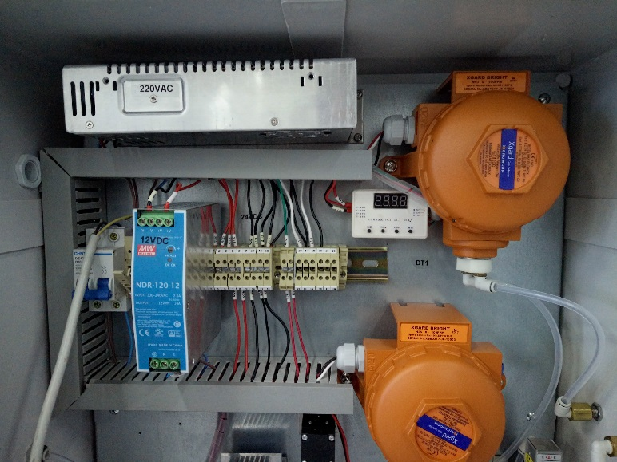
Sampling System for Wastewater

Slide 25
Why Sampling System?
Tailored and custom build to customer need
Multiple sampling line to one system - enabling the monitor of gases, from various locations
Eliminating costly downtime caused by sensor failure
Positioned away from the sample environment to ensure easy, safe access
Installed and commissioned for you on site by our trusted partners
Ongoing support, maintenance and servicing provided
Visit our website to download whitepaper & watch video
Join our webinar on 17th June on Sampling Systems

Slide 26
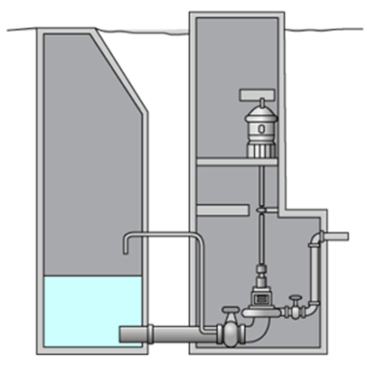
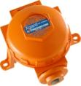
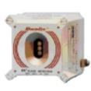
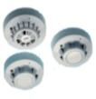
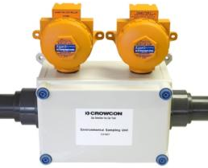
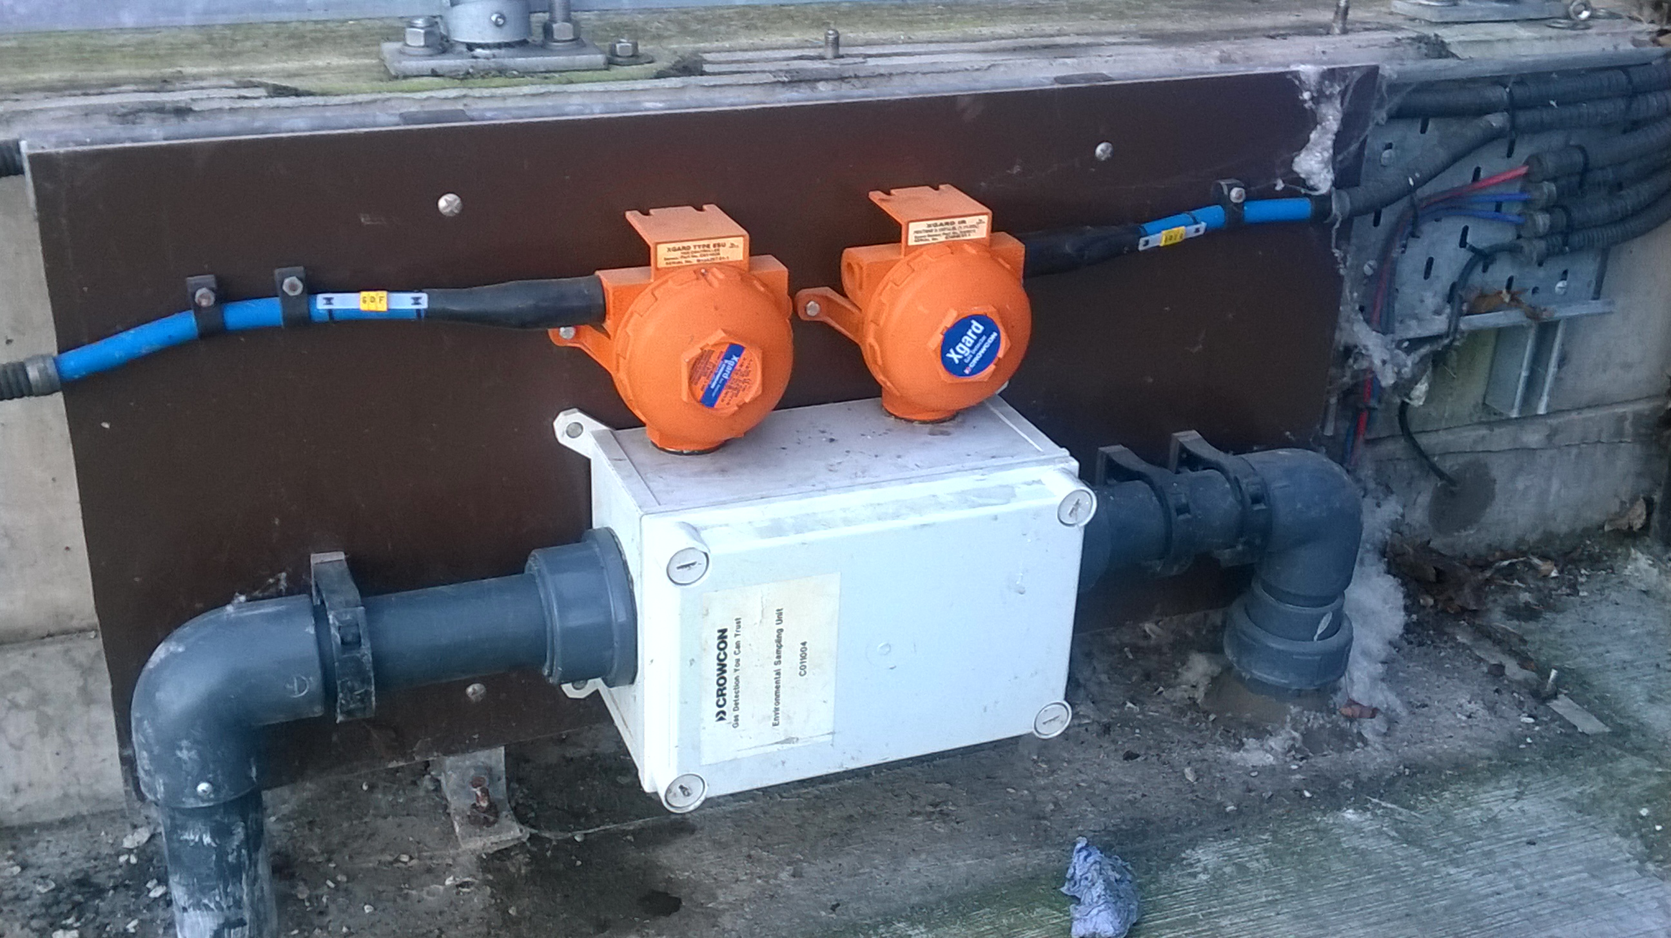
Primary Treatment
Pumping Station
Toxic Gas Detectors
V.F.C (Volt-Free Contacts)
Audio/Visual & Solenoid valves
Flammable gas Detectors
4-20mA outputs
LCD Display, PLC/DCS/BMS systems
RS-485 Modbus
PLC/DCS/BMS and SCADA systems
Smoke/Heat Detectors
Remote inhibit
& reset switches
Xgard ESU
Audible/Visual
Alarms

Slide 27
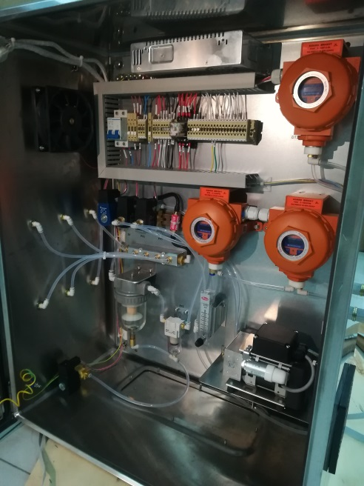
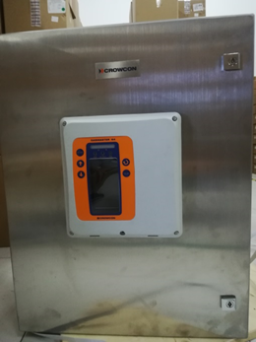
Primary Treatment
Underground Wastewater treatment
Underground plant is the confined space, more gas detectors required
Gases detected: O2, H2S, CH4 and NH3
One detector has area coverage of around 80-175m2
Our solution:
Gasmaster + Xgard Type 1 or Xgard Type5 with sounder/beacon

Slide 28
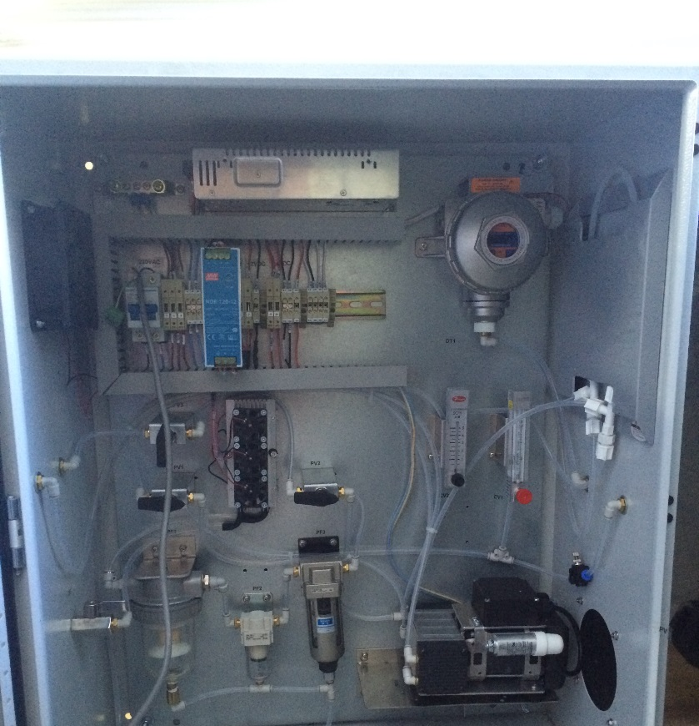
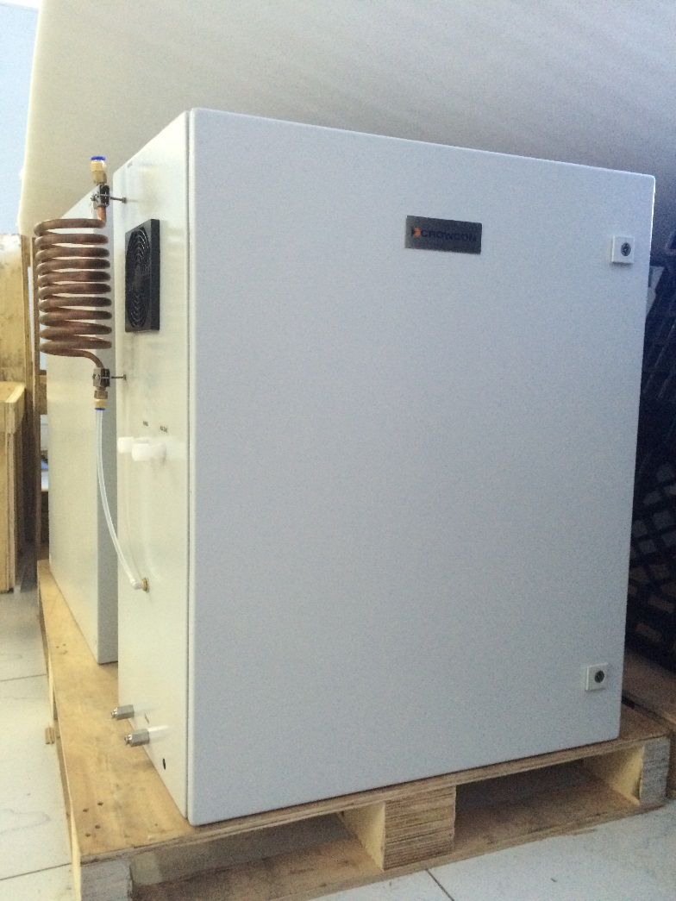
Secondary Treatment
Sludge drying:
Gas detected: O2, CO, H2S, CH4
Consideration: high temp in heat recovery boiler, high dust content
Sludge storage:
Gas detected: H2S, NH3, CH4
Consideration: Dust and water vapour
Solution: Xgard1, Xgard5 + Gasmaster or Xgard Bright with sampling system

Slide 29
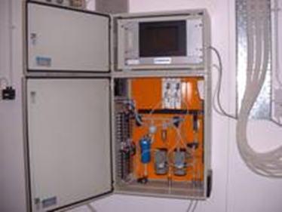
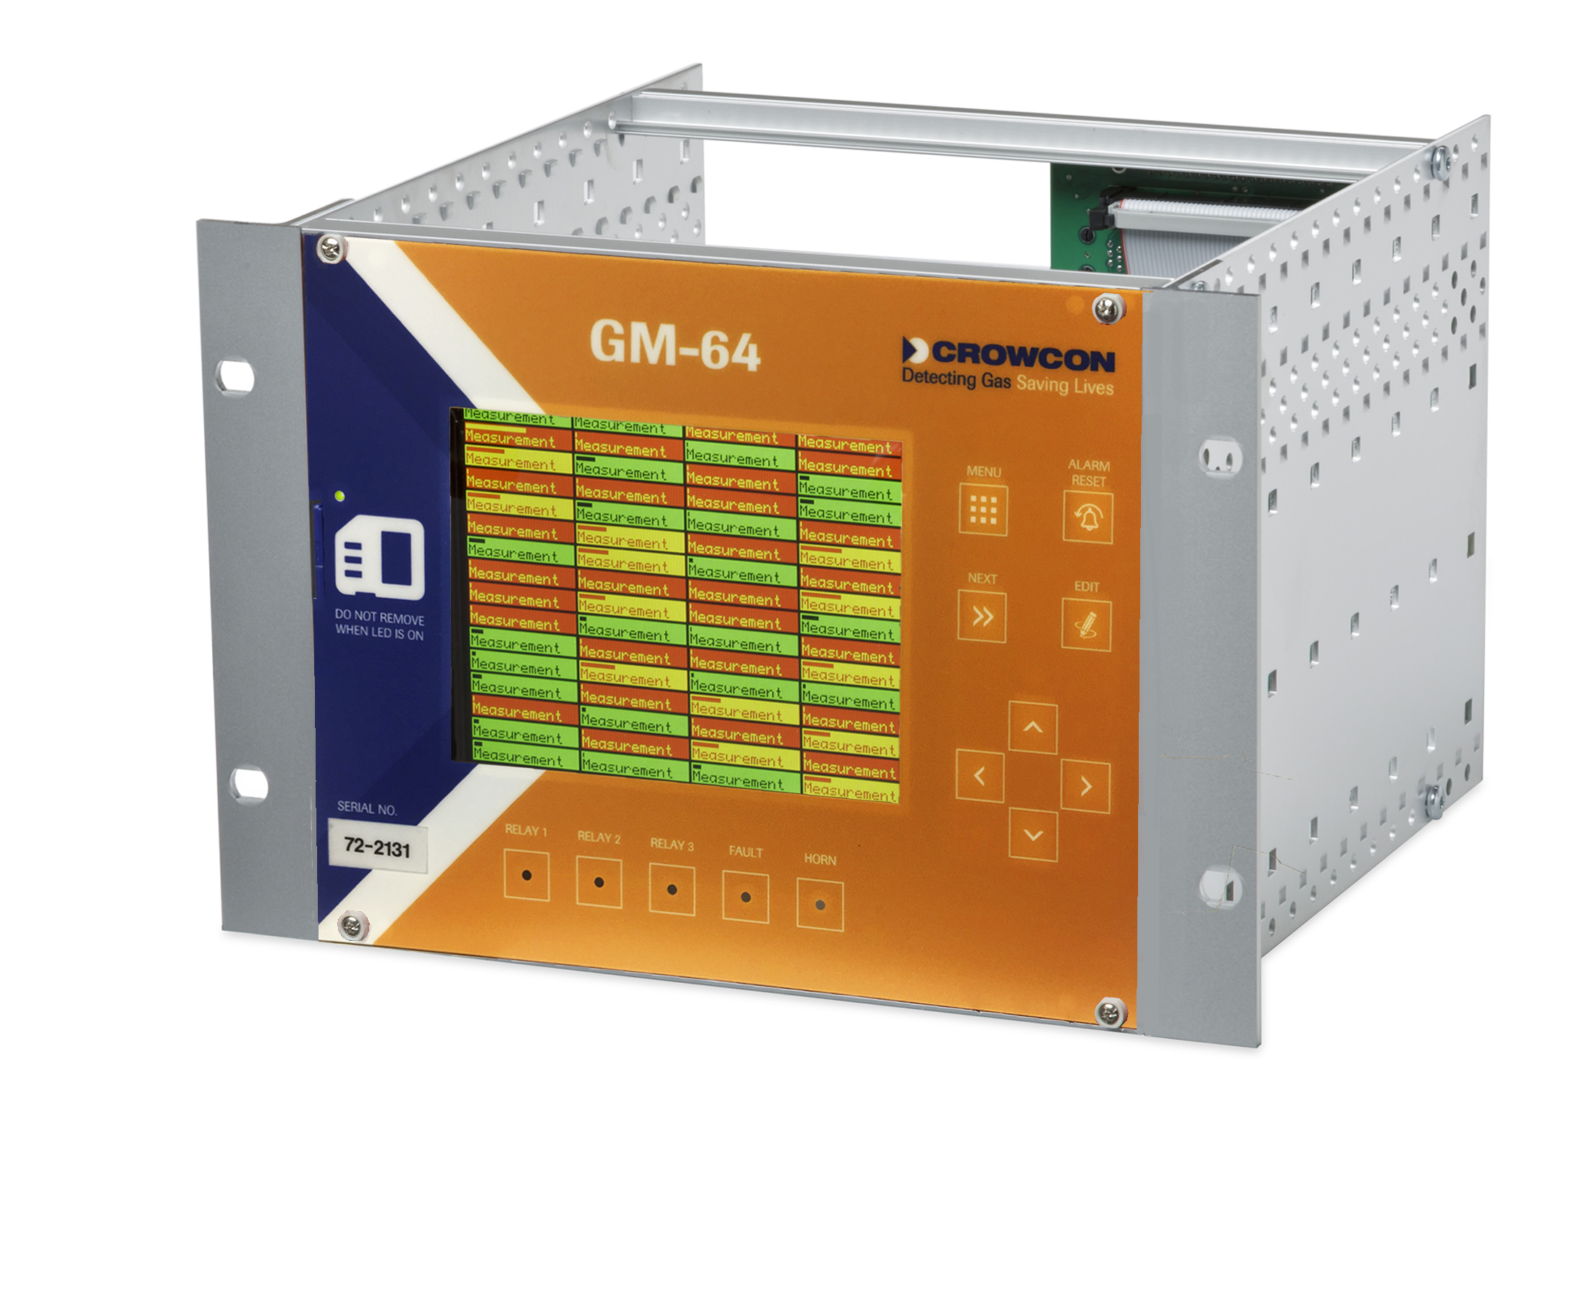
Secondary Treatment
Biogas Monitoring:
Monitors inlet and outlet of H2S scrubber before generator. Also monitors CH4 to for engine efficiency.
Gas detected: H2S, CH4 (IR)
Consideration: high moisture, high H2S, boiler, elevated pressure
Solution: Xgard1, IRmax + GM64 or Vortex with sampling system

Slide 30
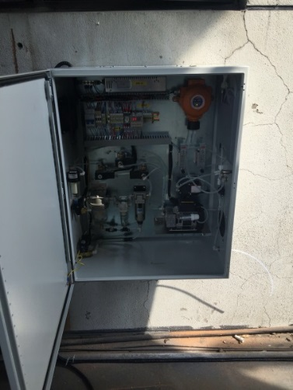
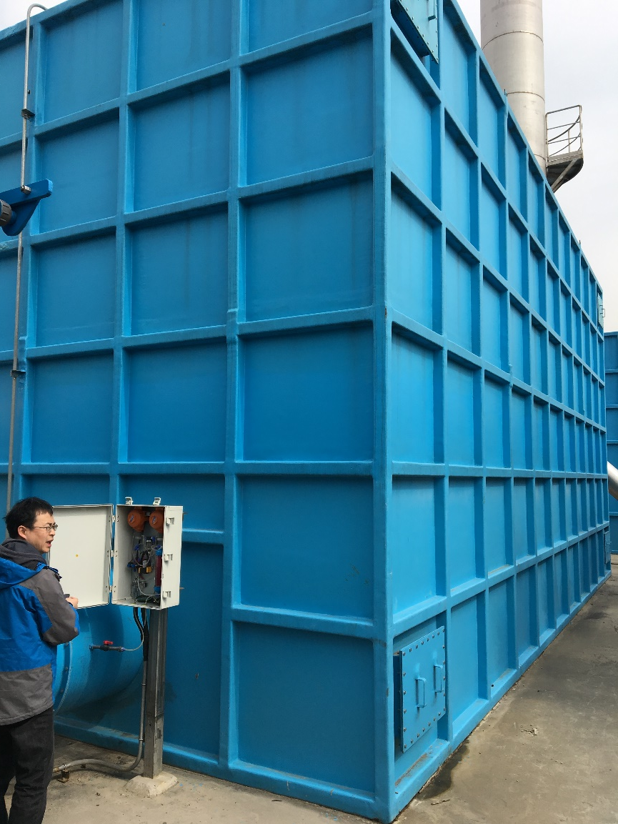
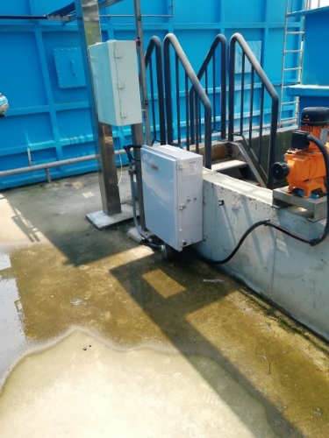
Secondary Treatment
Deodorisation Facility
Main application points:
Exhaust outlet and suction inlet of deodorization equipment: Each needs one NH3 detector and one H2S detector;
Some places require CH4 to detect flammables
Consideration: high dust and moisture content
Notes:
There are the picture of deodorization[di:əʊdəraɪ'zeɪʃən] equipment in Bailong sewage[ˈsu:ɪdʒ] plant, one of the biggest sewage plant in China
The method for clear odor include biology, chemistry and biology-chemistry. The detectors were installed on the chimney The exhaust outlet has one detector/NH3(0-25ppm) and one detector/H2S(0-20ppm). The inlet has one detector/NH3(0-100ppm) and one detector/H2S(0-200ppm). They need the data to check their plant is OK or not.

Slide 31
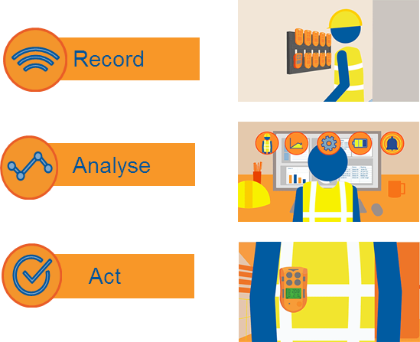
Next Steps
Identify potential buyers:
Plant owners and contractors
Consultants
OEM supplier
Safety inspectors
Chemical supplier
Identify customer pain point and address these pain points with Crowcon solution
Lead with data solutions and sampling systems
* Recording and presentation will be available on our website

Slide 32
Questions?

