Slide 1
Housekeeping
Please mute your microphones.
Post any questions in the chat – will be answered at the end.
This webinar will be recorded.
All recordings and presentations will be on the website shortly after the webinar here: www.crowcon.com/webinars

Slide 2
Gas Detection Requirement in Marine Industry
May 2020

Slide 3
Outline
Introduction
Marine Regulation and Classification
Where are the gas risks
Gas detection requirement
Fire and gas system
IMO2020 and its impact

Slide 4
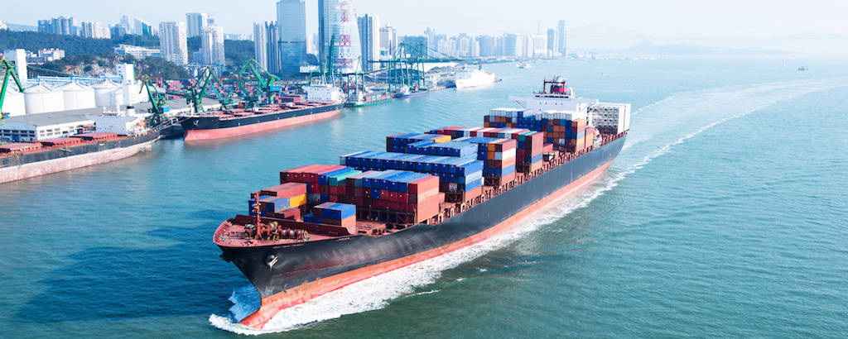
Introduction – What is Marine Industry
More than 90% of the global trade flow involves shipping
Maritime & Shipping = transport of goods/people via waterways
Includes container, ferry, leisure cruise, navy ships
Involves a large array of services including logistics, technical, surveying commercial & legal.
Marine & Offshore = Design, construction and installation of facilities in a marine environment, typically for the generation of resources such as oil, gas or electricity
Includes FPSO, oil tanks, offshore rigs
Involves onshore/port support, maritime services & offshore/ marine engineering

Slide 5
IMO: SOLAS Convention
International Maritime Organization (IMO) is an agency of the United Nations which has been formed to promote maritime safety
The IMO sets standards for the safety and security of international shipping (SOLAS & MARPOL)
SOLAS is abbreviation for “Safety Of Life At Sea” which is a convention that establishes the least safety measures in the construction, equipment and operation of merchant ships.
Total 14 chapters – in which chapter XI I & II are special measures to enhance maritime safety
In addition to SOLAS & MARPOL, many countries have also introduced their own safety & environmental regulations and policies.

Slide 6
Marine Standards and Certification
Products installed on any marine vessel need to comply with internationally recognized regulations.
The international standards that apply to a vessel are dependent upon where it is registered. Examples of countries and relevant standards are:
EU countries: MED (Marine Equipment Directive 2014/90/EU)
North America: US Coast Guard (USCG) regulations.
Both EU and US has Mutual Recognition Agreement (MRA)
Classification Societies members issue classification certs for vessels. They also certify that equipment meet marine & offshore rules
Certified equipment can carry a MED mark of conformity (aka wheelmark)

Slide 7
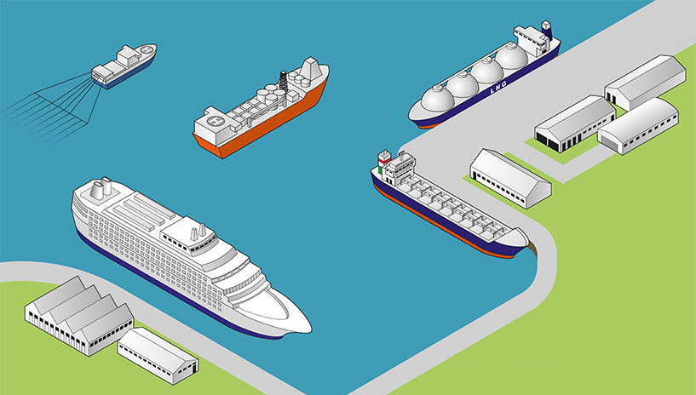
Gas Detection in Marine industry
1. Confined space entry
2. Inert space monitoring
3. Port/ onshore support
4. Gas detection system

Slide 8
Gas Detection Application in Vessels
Vessel Type | Application
FPSO (Floating, Production, Storage and Offloading) | Flammable gas and hydrogen sulphide detection. Flammable gas leak detection in pump rooms. Nitrogen is used to inert tank voids, therefore oxygen detectors are necessary where the nitrogen is stored. Hydrocarbon and oxygen monitoring during the purging of tanks.
Tankers | As above.
Ferries | CO and NOx accumulation from vehicle exhausts.
Submarines | Hydrogen detection in battery rooms. CO₂ leaks from air conditioning systems.
General | CO and NOx detection in engine rooms. H₂S and O₂ depletion in Bilges arising from the on-board sewage treatment plant. Vessels carrying food produce such as grain will sometimes install H₂S detectors.
Cargo Tanks | Vapour Emission Control Systems to analyse waste vapour gas for oxygen gas content.

Slide 9
Confined Space Entry (CSE) Requirement
SOLAS regulations XI-1/7 states vessels have at least one portable gas monitor on board for oxygen and flammable gas detection. Also states every ship must carry at least one appropriate portable atmosphere testing instrument which, as a minimum, is capable of measuring concentrations of oxygen (O2), flammable gases or vapours, hydrogen sulphide (H2S) and carbon monoxide (CO) prior to entry into enclosed / confined spaces
ability to remote sample, to perform a self-test, to have a minimum battery run-time of 10 hours and have clear instructions.
SOLAS Resolution A.1050(27) defines enclosed space as:
2.1 a space which has any of the following characteristics:
Limited openings for entry and exit;
Inadequate ventilation; and
Is not designed for continuous worker occupancy.

Slide 10
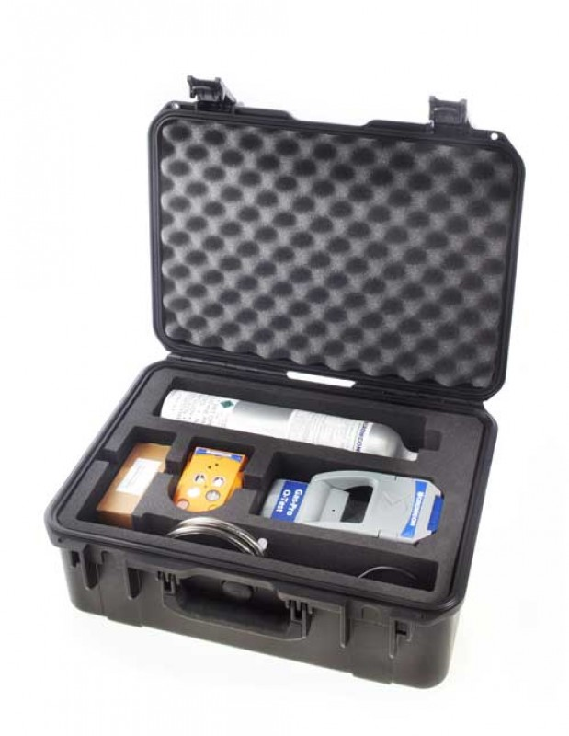
Gas-Pro for CSE
Marine Equipment Directive: MED 1500009
Built in pump – no bulky accessories
Automatic fail-safe flow plate recognition – takes away the pain of pre-entry testing
Specific and unique Pre-Entry Check (PEC) mode
Reliable lithium-ion battery – provides over 14 hr use from a 7.5 hr charge
Water and dust resistant to IP65 and IP67 – capable of withstanding harsh environments
Bump and calibration reminders
CSE KIT: Hard shell case including foam insert with space for Q-Test, gas cylinder, power and comms cable, drop line, Gas-Pro, flow plate, filters, chest harness and straps

Slide 11
T4 for Port Side/Onshore Support
Nature of the marine industry is such that vessel spent long time away from port
Once vessel is docked, quick turnaround is a given
Availability of supplies is an important consideration
We work with a multinational distributor (non exclusive) which provides safety solutions to the marine industry.
T4’s solution
Reliable, easy and intuitive to use,
Easy to calibrate, on-board and ability to generate reports demonstrating compliance.
Easy to read Quick Start Guide.

Slide 12
Gas-Pro TK for Inert Space Monitoring
Cargo tanks carry a multitude of liquids that can be flammable and/or toxic.
Inert gas blanketing protects by creating an inert atmosphere above the cargo.
An inert space on-board a ship can be maintained using engine exhaust, nitrogen, or other gas mixtures.
It is common practice for empty tanks spaces to remain inert in readiness for the next cargo load.
Gas-Pro TK solution
IR technology measure flammable gases without presence of oxygen.
Allows measurement over %LEL & %vol range (dual range)
Tank check mode (with alarms disabled)

Slide 13
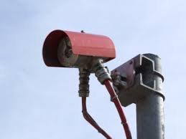
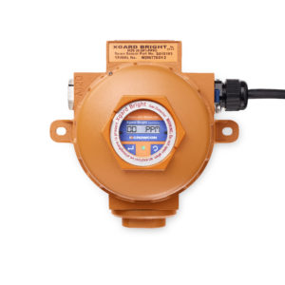
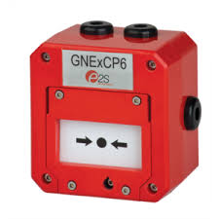
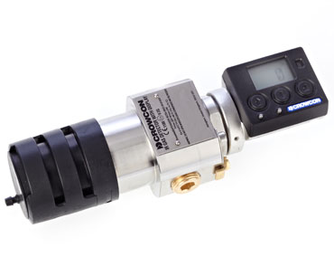
Fire & Gas Detection System
The construction of a vessel and the flammable and explosive material that it carries make fire-fighting very dangerous
Prevention and detection is therefore of utmost importance.
Solas requires regular check for fires on board done through automation.
F& G system consist of
Optical flame detector
Fixed gas detector
Smoke detector
Manual call point
Control system
Can be conventional or addressable
Addressable system can pinpoint where a fire or alarm takes place

Slide 14
Fixed Gas detection system
Fixed gas detection system allows gas monitoring in tanks, void spaces, pump room or cabin space adjacent to cargo storage tanks and handling systems.
Monitors O2, H2S and occasionally HC
Crowon supplies many detectors to OEM as part of their supply
Crowcon’s addressable controller GM64 with Xgard Bright allows integrator seamless integration
MED approval is given as whole package hence individual detector approval is not necessary

Slide 15
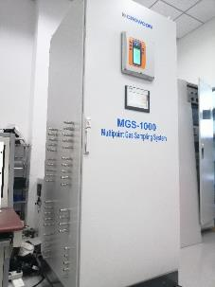
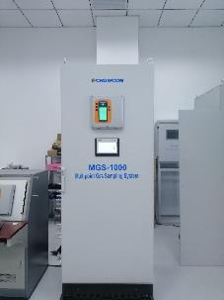
Sampling System in Chemical Tanker
Multipoint gas detection in vessels, sampling from ballast tanks, CCR, cofferdams, etc.
Measured gases: HC, O2, H2S
Equipped with addressable controller, automatic calibration facility, and HMI system for data logging and trending
Solves difficulty in maintenance and calibration of detectors in inaccessible areas
Saves long cabling costs
End user: Dangerous Cargo Vessel
Notes:
Case study:
Name of end user:
Ship owner: GEFO Gesellschaft für Oeltransporte mbH
Shipyard: AVIC Dingheng Shipbuilding Co., Ltd.
Quantity: 6 sets of gas sampling and monitoring systems
Monitored gas: H2S, O2, HC
The customer needs to monitor the situation of dangerous gas in a confined space of the tanker to ensure ship and crew safety;
The gas detection system is indispensable for a chemical tanker. A chemical tanker without the gas monitoring system is unseaworthy.
Crowcon product is used in the chemical tanker to monitor gas in a confined space of the tanker. The gas is pumped into the sampling system and then detected.

Slide 16
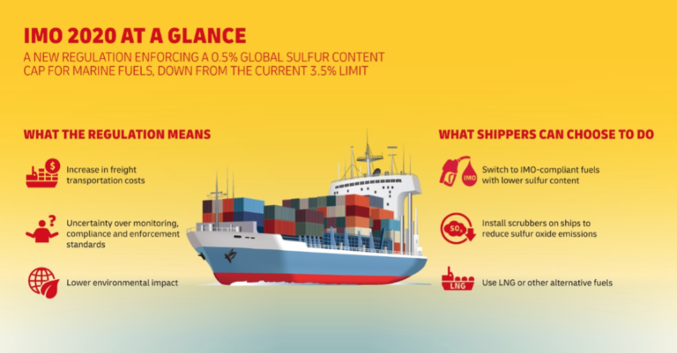
IMO 2020: Opportunity for Gas Detection
http://westpacificmarine.ca/2019/09/imo-2020-fuel-standards-rapidly-approaching/
Opportunity for SO2 monitoring in scrubbers
More requirement for flammable gas detector as LNG is highly explosive

Slide 17
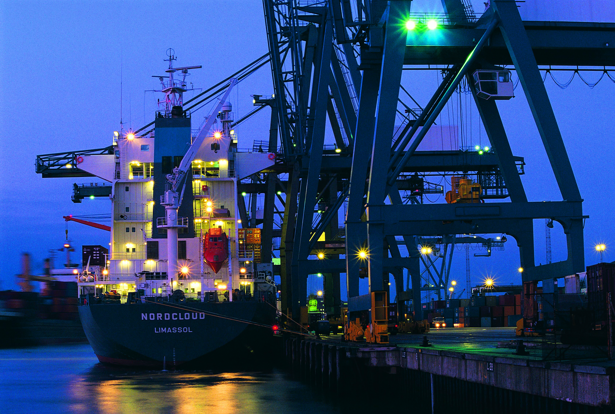
Next Steps
Identify potential buyers:
Shipyard owners and contractors
Ship owner and chandlers
Skid manufacturer
EPC
Marine supply store
Lead with Crowcon’s worldwide support and service centres.

Slide 18
Questions?

